Slide 1


Airline Fare Prediction
Using Machine Learning Models
Submitted To:-
Prof. Phenil Buch
Assistant Professor
Department of Computer Science EngineeringS
Made By:
Miti Nayak(17DCS034)
Dhrumil Patel (17DCS040)
Jahnavi Shah (17DCS058)

Slide 2
BACKGROUND THEORY
Nowadays, the airline corporations are using complex strategies and methods to assign airfare prices , in a dynamic fashion. These strategies are taking into account several financial, marketing, commercial and social factors closely connected with the final airfare prices.
Due to the high complexity of the pricing models applied by the airlines, it is very difficult for a customer to purchase an air ticket in the lowest price, since the price changes dynamically. For this reason using several techniques we will provide the right time for the buyer to purchase an air ticket by predicting the airfare price, have been proposed recently.

Slide 3
PROJECT DEFINITION
The airline implements dynamic pricing for the flight ticket. According to the survey, flight ticket prices change during the morning and evening time of the day. Also, it changes with the holidays or festival season,thus many of us might have often heard travellers saying that flight ticket prices are so unpredictable.
Hence,this project deal with prediction of the best prices for the customers as they are the most affected due to the fluctuation in ticket price. So in this project we are using various machine learning model i.e Linear Regression,Ridge regression,Lasso Regression,Light GBM and on the basis of root mean squared error of each model the most suitable model is obtained. Then the prediction for the given dataset is carried out using that model which is Light GBM in this case..

Slide 4
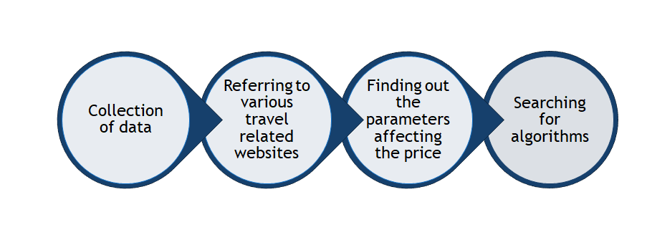
REQUIREMENT GATHERING

Slide 5
SOFTWARE AND HARDWARE REQUIREMENTS
HARDWARE REQUIREMENT :Processor: Intel dual core or above
Processor Speed:1.0GHZ or above
RAM: 2 GB RAM or above
Hard Disk: 10 GB hard disk or above
SOFTWARE REQUIREMENT
Software used is Google Collaboratory.

Slide 6
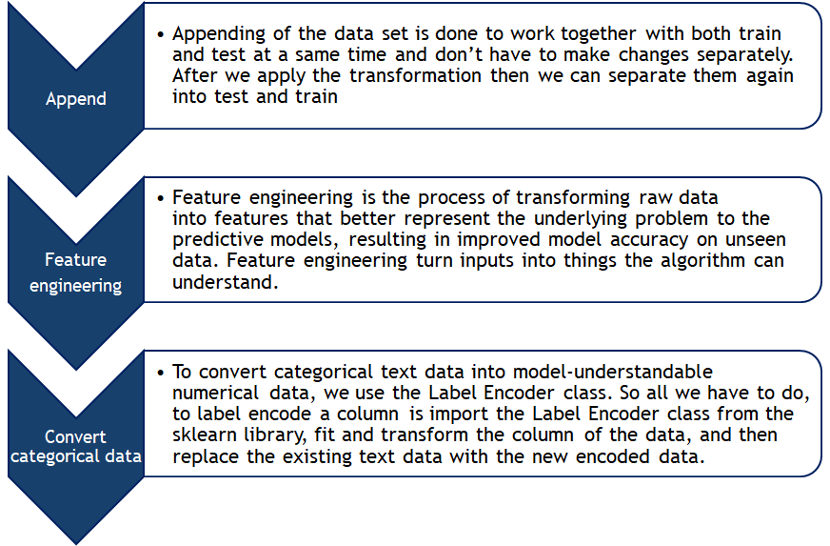
DATA PREPARATION

Slide 7
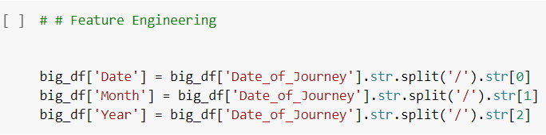
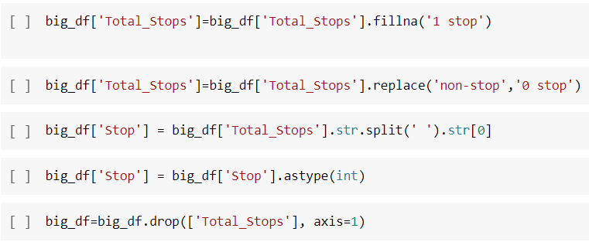
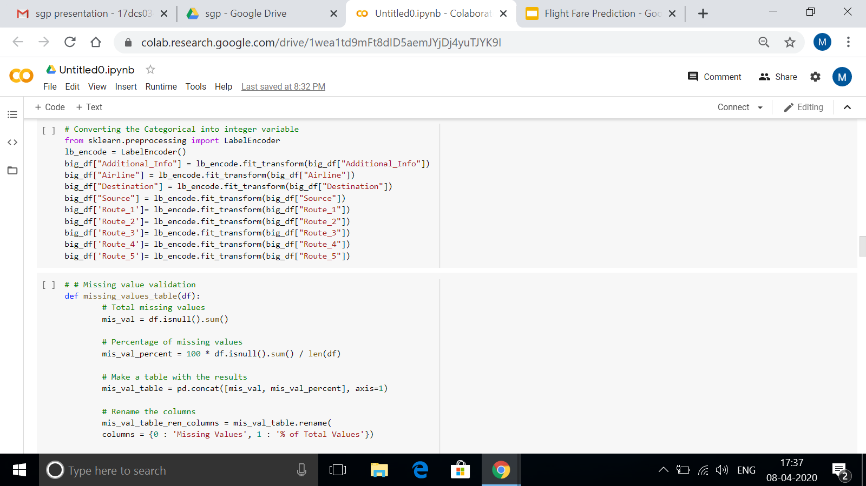
SCREENSHOTS

Slide 8
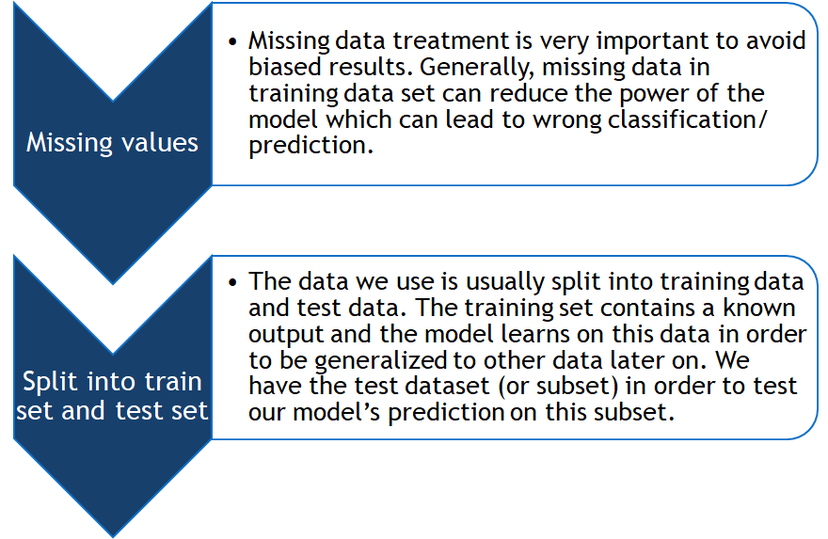

Slide 9
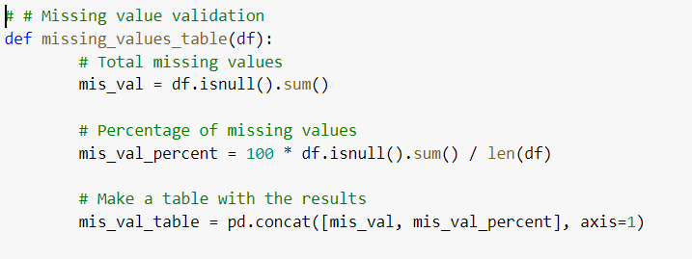
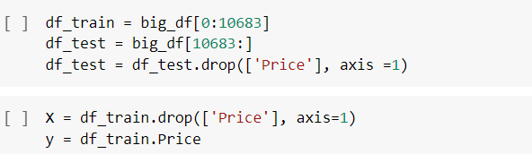
SCREENSHOTS

Slide 10
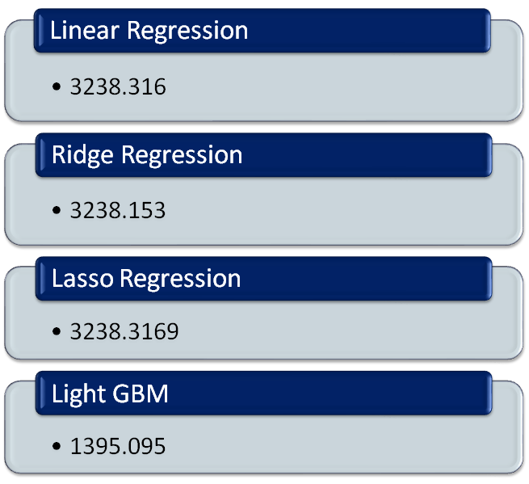
MODELS

Slide 11
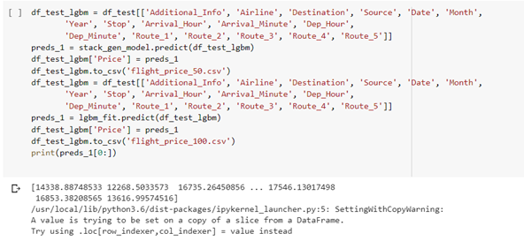
SCREENSHOTS
The final outcome

Slide 12
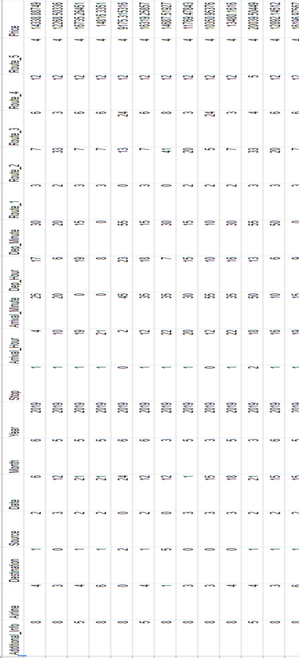
SCREENSHOTS
The above figure represents the screenshot of the predicted dataset

Slide 13
PRACTICAL OUTCOME
Since the root mean square of LIGHT GBM (1395.153) machine learning algorithm is lowest of the the different models implemented i.e. Linear regression (3238.316),Ridge Regression (3238.153),Lasso Regression(3238.169).
Thus the airline fare is predicted using LIGHT GBM model.

Slide 14



EXAMPLE
Training Set
Test Set
Prediction Set

Slide 15
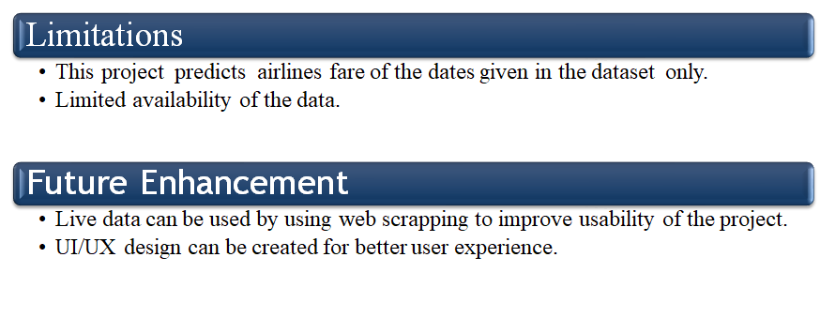
LIMITATION AND FUTURE ENHANCEMENT

Slide 16
REFRENCES
https://www.semanticscholar.org/paper/Airfare-prices-prediction-using-machine-learning-Tziridis-Kalampokas/124250a5ff813e30d9305c26db8896c2278dca8d
https://youtu.be/jxKg65AimSI
https://youtu.be/72hlr-E7KA0
https://analyticsindiamag.com/flight-ticket-price-prediction-hackathon-use-these-resources-to-crack-our-machinehack-data-science-challenge/
https://ieeexplore.ieee.org/document/8081365

Slide 17
THANK YOU

